Slide 1
SMART DISEASE DETECTION SYSTEM IN PLANTS
BY: Guide By:-
Rohan O Chikorde Prof. Prasad Pujar
Shubhma Godse Dept CSE
Abhishek Shelke
Ifran Hussian

Slide 2

Contents:
Introduction
Literature review
Objectives
Existing Methodology
Proposed Methodology
System Design
Road Map
References

Slide 3

INTRODUCTION
A Smart Disease Detection System in plants and crops refers to the utilization of advanced technologies such as machine learning to accurately identify, diagnose, and monitor diseases affecting agricultural plants and crops. The goal of these systems is to improve the efficiency and precision of disease detection, enabling farmers to implement timely and effective management strategies to protect crop health and enhance agricultural productivity..

Slide 4

LITERATURE REVIEW
Agricultural productivity is crucial for food security and economic stability, and one of the biggest challenges it faces is the spread of diseases that affect crops.
Traditional disease detection methods rely heavily on expert knowledge, visual inspections, and labor-intensive practices that may delay the identification of diseases.
Consequently, the need for smart, automated disease detection systems has grown significantly.
Recent advancements in technologies such as machine learning, computer vision, and the Internet of Things (IoT) have enabled the development of Smart Disease Detection Systems (SDDS) for plants and crops, providing precise and timely information to farmers for managing crop health.

Slide 5

OBJECTIVES
Enhance Early Disease Detection: Develop an automated system capable of identifying diseases at the earliest stage to prevent their spread and reduce crop losses.
Increase Detection Accuracy: Utilize advanced machine learning and computer vision techniques to accurately detect and classify various crop diseases across different plant types.
Promote Cost-Effectiveness: Ensure the system is cost-effective for small-scale farmers, making advanced disease detection technology accessible to a broader agricultural community.
Facilitate User-Friendly Access: Develop a user-friendly interface for farmers, allowing easy access to disease detection reports, monitoring data, and alerts via mobile devices or web platforms.

Slide 6
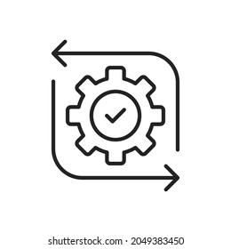
EXISTING METHODOLOGY
Traditional Visual Inspection Description: Farmers or agricultural experts manually inspect crops for signs of disease, often identifying issues based on color changes, spots, or deformities in leaves and stems.Limitations: This method is time-consuming, requires expertise, and is prone to human error. Early disease symptoms may be difficult to detect visually, leading to delays in intervention.

Slide 7

PROPOSED METHODOLOGY
Data Collection: Capture plant images, deploy IoT sensors (temperature, humidity, soil moisture) for real-time monitoring, and use historical disease data.
Data Preprocessing: Enhance image and sensor data quality; label images with disease types for accurate model training.
Model Training: Train a CNN for image-based disease detection, apply transfer learning for adaptability, and develop models to analyze environmental data from IoT sensors.
Interface: Provide a mobile app and dashboard for easy access to disease diagnostics, sensor data, and alerts.
Field Testing & Deployment: Validate in-field, deploy on cloud platforms, and maintain cost-effective, sustainable IoT solutions for continuous crop health monitoring.

Slide 8
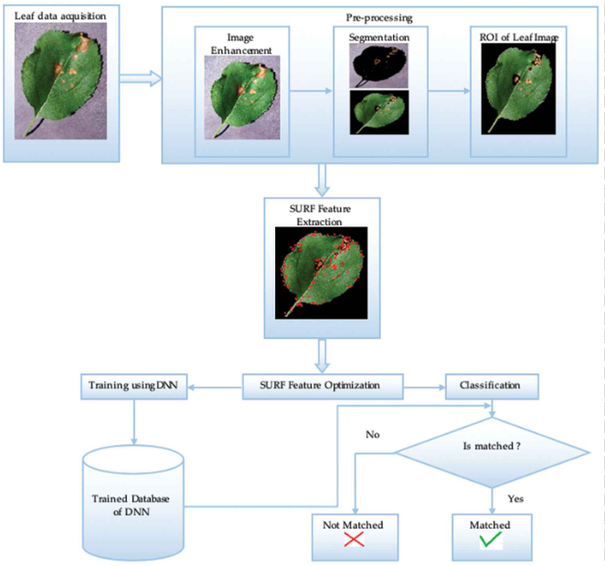
SYSTEM DESIGN
Segmentation: This sub-step involves separating the leaf from the background.
ROI (Region on Interest) of Leaf Image: The segmented leaf image is obtained, highlighting the specific areas of the leaf that need to be analyzed for disease symptoms.
Speeded-Up Robust Features (SURF) is an algorithm used for feature detection. In this step, SURF is applied to extract key features from the leaf image.

Slide 9
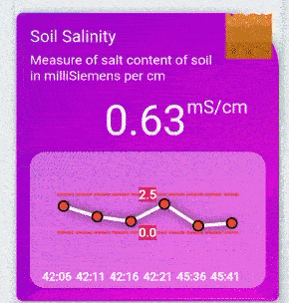
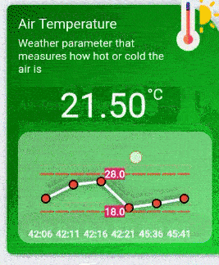
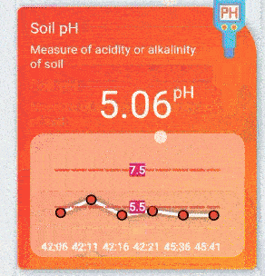
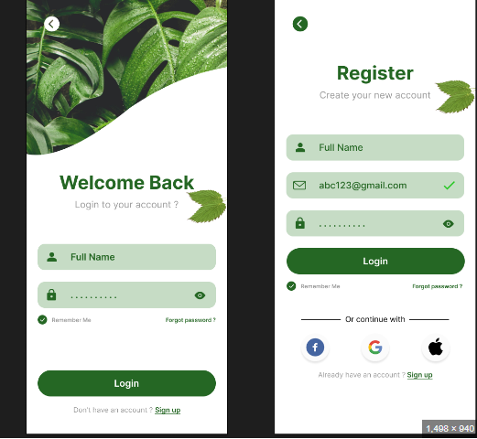
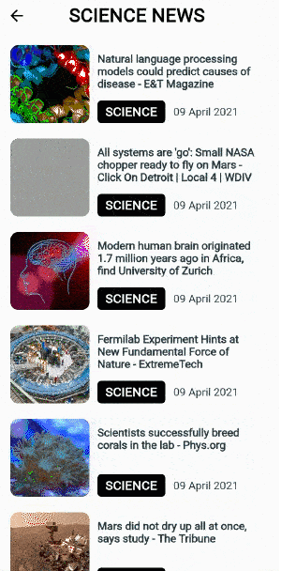
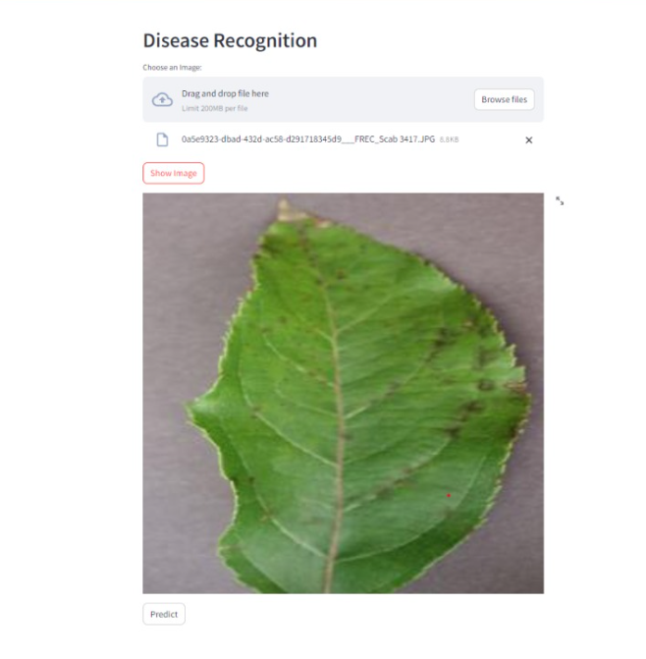
SYSTEM DESIGN

Slide 10


ROAD MAP
Research & PlanningDefine
goals & audience.
Market analysis.
Technology Selection
Choose sensors & processing method.
Select ML frameworks.
System Design
Design architecture & UI.
Create database schema.
Data Collection
Gather & label datasets.
Model Development
Preprocess data & train models.
Evaluate performance.
Deployment
Develop deployment strategy.
Train users.
Monitoring & Maintenance
Continuous performance monitoring.
Regular updates.
Testing & Validation
Conduct field tests.
Gather feedback.
Integration
Combine sensors, models, and UI.

Slide 11
Thanks You !

Slide 12
EXTRA CONTENT
Objectives
Scope / Objectives of the project:
1. To Enhance early disease detection.
2. To implement the ML algorithms for time consumption.
3. To Increase the detection accuracy.
4. To Provide supplement details for the disease detected.
5. To enhance crop health and yield.
6. To Facilitate user-friendly access to the system.
7. To develop a Real-Time Monitoring Dashboard.

Slide 13
Methodology:
1. Web-Based Detection interface: Develop a user-friendly platform for disease detection in plants.
2. Implement Machine Learning Algorithms: Develop an AI model for image based detection using CNN algorithm.
3. Supplement information: Develop the model to provide the supplement details for the disease detected and market support.
4. Monitoring dashboard: Develop the monitoring dashboard to visualize the moisture sensor details and control various hardware equipment’s.

Slide 14
Expected Outcome of the project:
1. A user-friendly web platform where farmers, agricultural consultants, or researchers can upload images of plants and receive rapid, automated disease diagnoses.
2. A trained Convolutional Neural Network (CNN) model capable of accurately classifying common plant diseases based on uploaded images.
3. Disease detection results are supplemented with actionable guidance on treatments, suggested supplements, and links to local or online suppliers.
4. A real-time monitoring dashboard that visualizes moisture levels and allows users to control irrigation, lighting, and other equipment as needed.

